Slide 1
Linear Model

Slide 2

Machine Learning
What would be the grade if I study 4 hours?
4 hours
? points
Prediction
Hours (x) | Points (y)
1 | 2
2 | 4
3 | 6
4 | ?
Training dataset
Test dataset

Slide 3
Math and computer approaches
Hours (x) | Points (y)
1 | 2
2 | 4
3 | 6
4 | ?
y = w * x → How do you know it is multiplication?
2 = w * 1 → Use labeled value to predict
w = 2 → This is math way

Slide 4
How about this?
Hours (x) | Points (y)
1 | 13.5724
7 | 10.23315
16 | 22.5731
224 | -15.7414
How do you know it is linear or not?
How can you know there exists a solution to this?
How can you know that some data are noise?

Slide 5

Machine Learning
What would be the grade if I study 4 hours?
4 hours
? points
Prediction
Hours (x) | Points (y)
1 | 2
2 | 4
3 | 6
4 | ?
Training dataset
Supervised learning
Test dataset

Slide 6
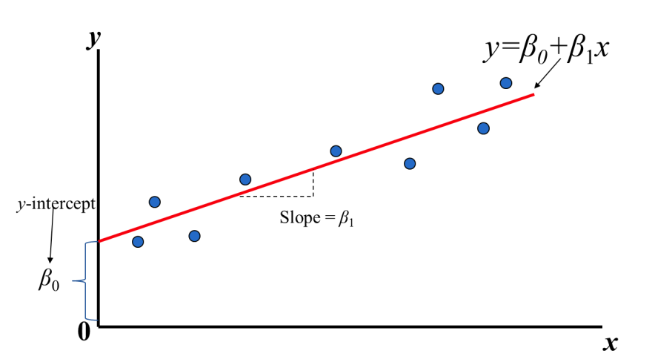
Draw a line
Find the line that best fits the distributoion
Hours (x) | Points (y)
1 | 2
2 | 4
3 | 6
4 | ?
Notes:
\hat{y}=x*w+b

Slide 7
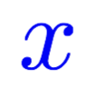
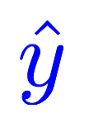
Model design
What would be the best model for the data? Linear?
Hours (x) | Points (y)
1 | 2
2 | 4
3 | 6
4 | ?
Linear
Notes:
\hat{y}=x*w+b

Slide 8


Model design
What would be the best model for the data? Linear?
Hours (x) | Points (y)
1 | 2
2 | 4
3 | 6
4 | ?
Linear
Notes:
\hat{y}=x*w+b

Slide 9
Linear Regression
Find the line that best fits the distributoion
Hours (x) | Points (y)
1 | 2
2 | 4
3 | 6
4 | ?
Notes:
\hat{y}=x*w+b

Slide 10
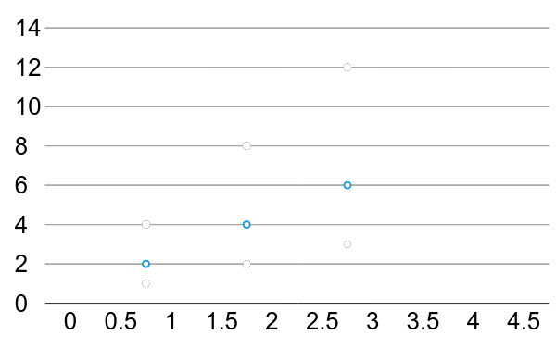
Linear Regression
For simplication, get rid of b
Hours (x) | Points (y)
1 | 2
2 | 4
3 | 6
True line

Slide 11
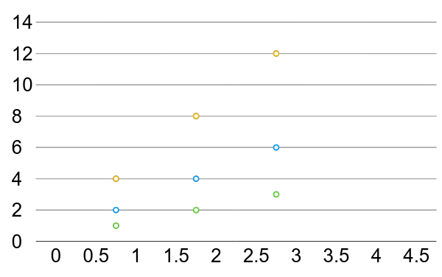
Linear Regression error?
* The machine starts with a random guess, w=random value
Hours (x) | Points (y)
1 | 2
2 | 4
3 | 6

Slide 12
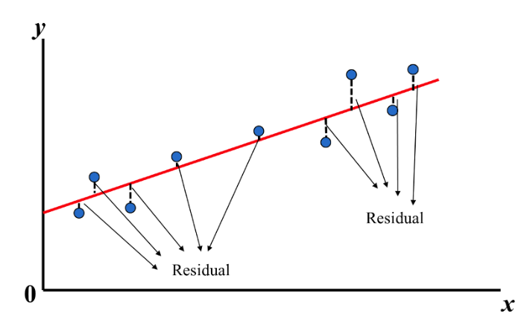
Linear Regression error?
Find the red line that all the ‘y’ distances are minimal
* The machine starts with a random guess, w=random value
Hours (x) | Points (y)
1 | 2
2 | 4
3 | 6

Slide 13
How to measure? We need a way to find if the line fits all the points The best way is to find the distances between points and the line

Slide 14
How to measure?

Slide 15
Training Loss (error) Make it positive and easy to get derivation
Hours, x | Points, y | Prediction, y^(w=3) | Loss (w=3)
1 | 2 | 3 | 1
2 | 4 | 6 | 4
3 | 6 | 9 | 9
 |  |  | mean=14/3
Notes:
loss = (\hat{y}-y)^2 = (x*w-y)^2

Slide 16
Training Loss (error)
Hours, x | Points, y | Prediction, y^(w=4) | Loss (w=4)
1 | 2 | 4 | 4
2 | 4 | 8 | 16
3 | 6 | 12 | 36
 |  |  | mean=56/3
Notes:
loss = (\hat{y}-y)^2 = (x*w-y)^2

Slide 17
Training Loss (error)
Hours, x | Points, y | Prediction, y^(w=0) | Loss (w=0)
1 | 2 | 0 | 4
2 | 4 | 0 | 16
3 | 6 | 0 | 36
 |  |  | mean=56/3
Notes:
loss = (\hat{y}-y)^2 = (x*w-y)^2

Slide 18
Training Loss (error)
Hours, x | Points, y | Prediction, y^(w=1) | Loss (w=1)
1 | 2 | 1 | 1
2 | 4 | 2 | 4
3 | 6 | 3 | 9
 |  |  | mean=14/3
Notes:
loss = (\hat{y}-y)^2 = (x*w-y)^2

Slide 19
Training Loss (error)
Hours, x | Points, y | Prediction, y^(w=2) | Loss (w=2)
1 | 2 | 2 | 0
2 | 4 | 4 | 0
3 | 6 | 6 | 0
 |  |  | mean=0
Notes:
loss = (\hat{y}-y)^2 = (x*w-y)^2

Slide 20
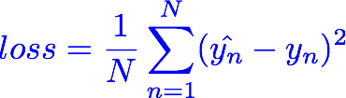
Training Loss (error)
MSE, mean square error
Hours, x | Loss (w=0) | Loss (w=1) | Loss (w=2) | Loss (w=3) | Loss (w=4)
1 | 4 | 1 | 0 | 1 | 4
2 | 16 | 4 | 0 | 4 | 16
3 | 36 | 9 | 0 | 9 | 36
 | MSE=56/3=18.7 | MSE=14/3=4.7 | MSE=0 | MSE=14/3=4.7 | MSE=56/3=18.7
Notes:
loss = (\hat{y}-y)^2 = (x*w-y)^2

Slide 21
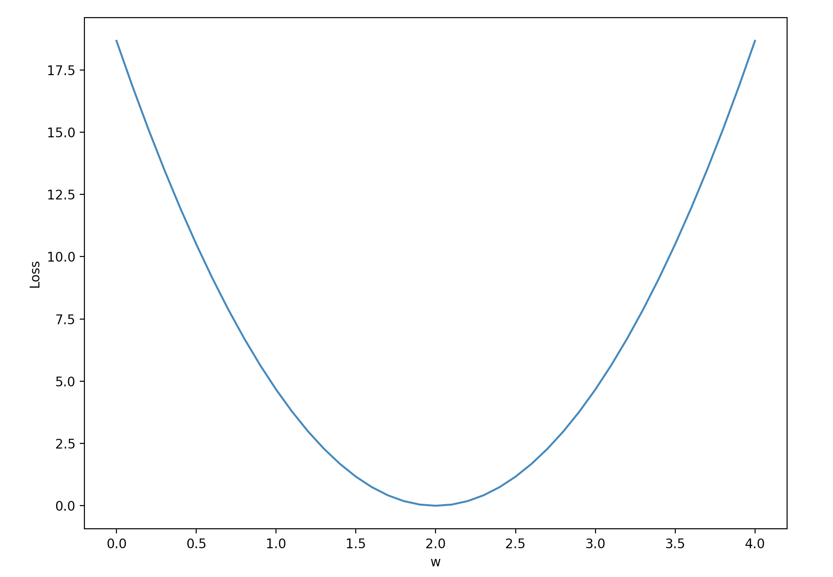
Loss graph
Loss (w=0) | Loss (w=1) | Loss (w=2) | Loss (w=3) | Loss (w=4)
mean=56/3=18.7 | mean=14/3=4.7 | mean=0 | mean=14/3=4.7 | mean=56/3=18.7
Loss
w
Notes:
loss = (\hat{y}-y)^2 = (x*w-y)^2

Slide 22
Loss graph
Loss (w=0) | Loss (w=1) | Loss (w=2) | Loss (w=3) | Loss (w=4)
mean=56/3=18.7 | mean=14/3=4.7 | mean=0 | mean=14/3=4.7 | mean=56/3=18.7
Loss
w
Notes:
loss = (\hat{y}-y)^2 = (x*w-y)^2

Slide 23

Model & Loss
w = 1.0 # a random guess: random value
# our model for the forward pass
def forward(x):
return x * w
# Loss function
def loss(x, y):
y_pred = forward(x)
return (y_pred - y) * (y_pred - y)

Slide 24
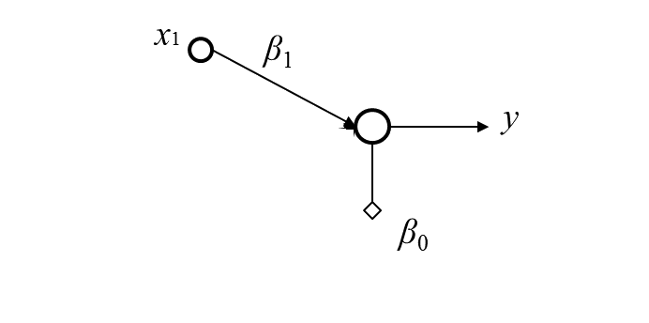
Linear Regression
One dimension linear regression

Slide 25
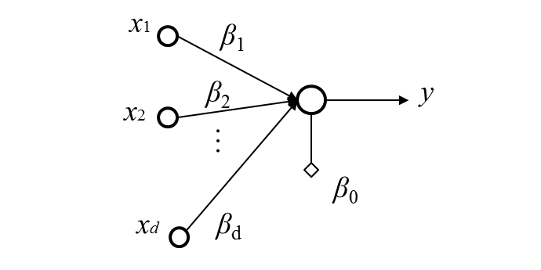
Linear Regression
Multi-dimension linear regression

Slide 26
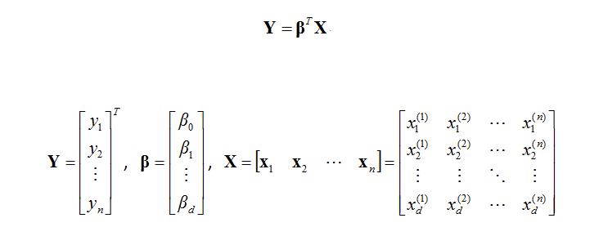
Calculate Bias and Weight
Notes:
loss = (\hat{y}-y)^2 = (x*w-y)^2

Slide 27
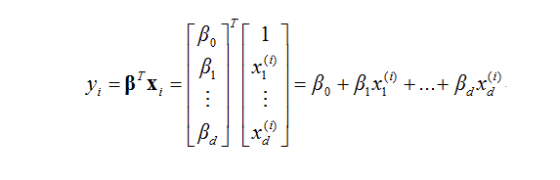
Calculate Bias and Weight
Notes:
loss = (\hat{y}-y)^2 = (x*w-y)^2

Slide 28
Gradient Descent

Slide 29
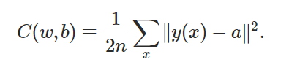
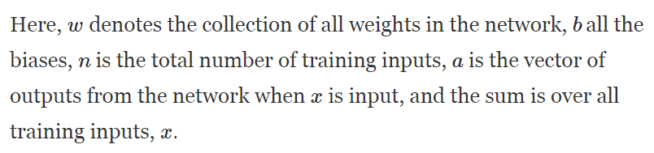
Loss(Cost) Function
Notes:
loss = (\hat{y}-y)^2 = (x*w-y)^2

Slide 30
Loss(Cost) Function
||v|| denotes a distance of a vector → A scalar
Square value → means it is always positive.
a = wx + b → A function of weights and biases.
The reason that the cost function doesn’t’ use an ‘absolute’ function is for smoothness. → Easy to calculate derivatives.
Notes:
loss = (\hat{y}-y)^2 = (x*w-y)^2

Slide 31


Loss(Cost) Function
Notes:
loss = (\hat{y}-y)^2 = (x*w-y)^2

Slide 32
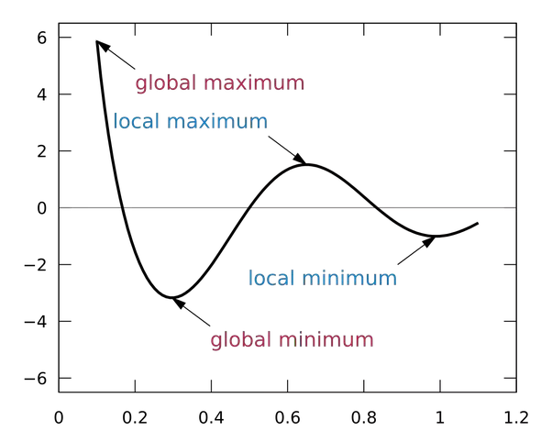
Find global minimum
Notes:
loss = (\hat{y}-y)^2 = (x*w-y)^2

Slide 33
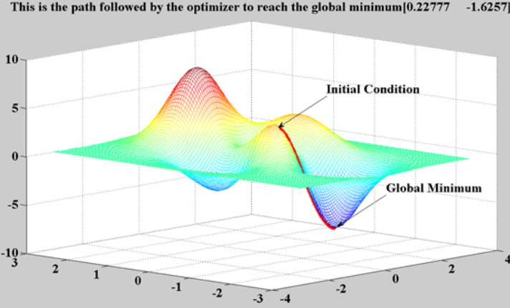
Find global minimum
Notes:
loss = (\hat{y}-y)^2 = (x*w-y)^2

Slide 34
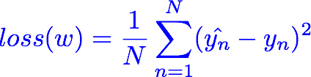
Loss(Cost) Function two dimension
Notes:
loss = (\hat{y}-y)^2 = (x*w-y)^2

Slide 35
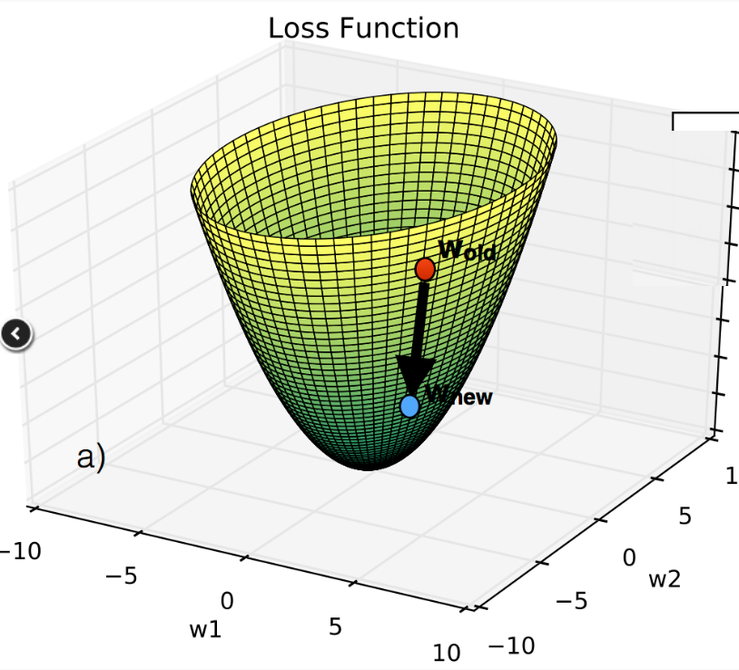
Loss(Cost) Function three dimension
Notes:
loss = (\hat{y}-y)^2 = (x*w-y)^2

Slide 36

Loss(Cost) Function n dimension
Notes:
loss = (\hat{y}-y)^2 = (x*w-y)^2

Slide 37
Problem Attacker
When there are no obvious MATH way to solve this problem, we switch to COMPUTER way.
Step by Step
Notes:
loss = (\hat{y}-y)^2 = (x*w-y)^2

Slide 38
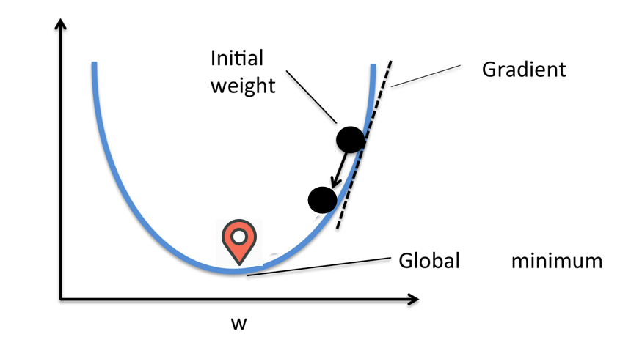
Move down a little step by step
For two dimension space, there is only ONE direction toward the bottom of global minimum, it is the tangent line direction.
Notes:
loss = (\hat{y}-y)^2 = (x*w-y)^2
\frac{\partial{loss}}{\partial{w}}=?

Slide 39
Find a point first Then find next point
Find a random point first, and try to find the next point that goes down the fastest. Repeat this procedure until we reach the global minimum.
Notes:
loss = (\hat{y}-y)^2 = (x*w-y)^2

Slide 40
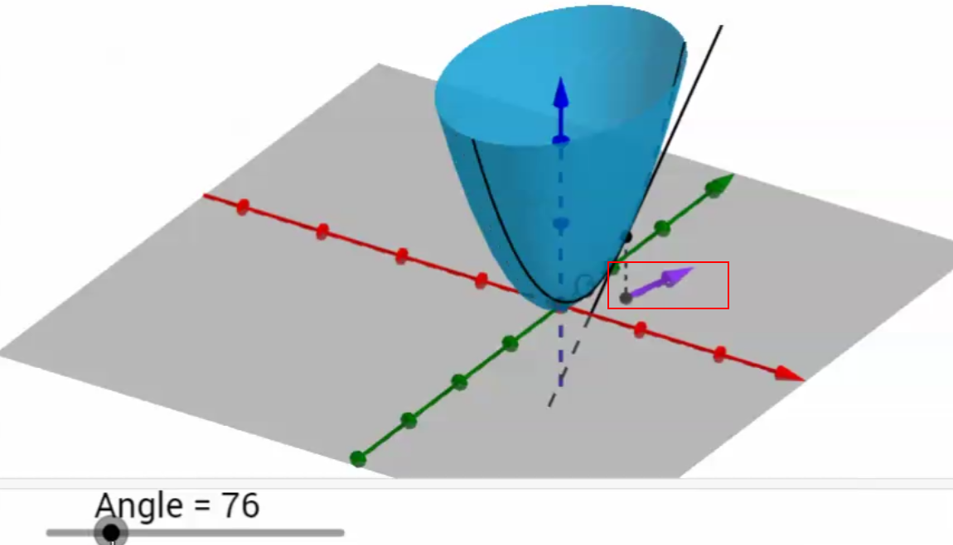
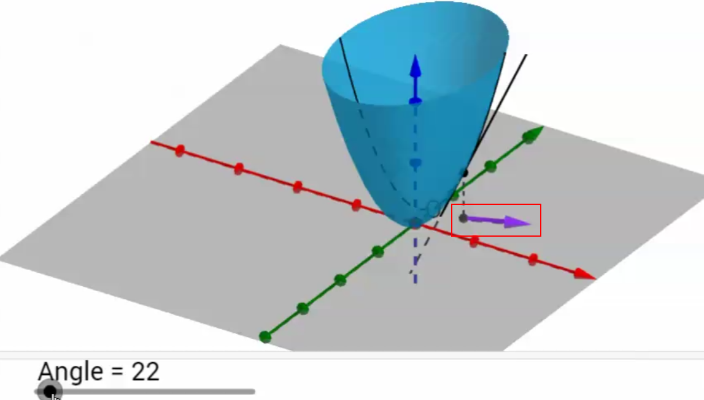
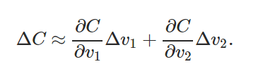
Move down a little step by step
For n dimension space, there are INFINITE directions toward the bottom of global minimum.
WHICH DIRECTION TO GO DOWN TO BOTTOM THE FASTEST?
Notes:
loss = (\hat{y}-y)^2 = (x*w-y)^2
\frac{\partial{loss}}{\partial{w}}=?

Slide 41


Slide 42
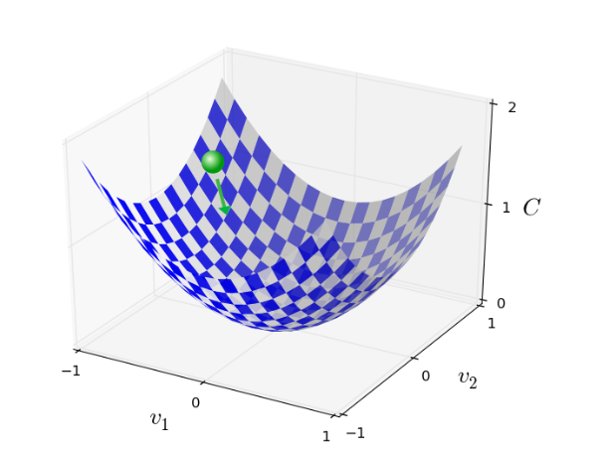
The Gradient Descent

Slide 43
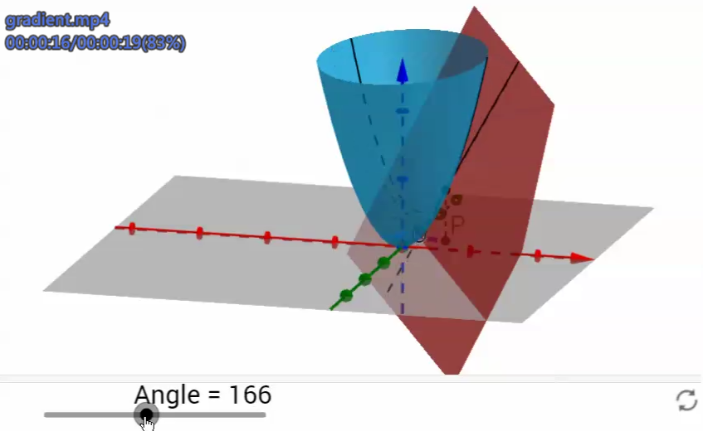
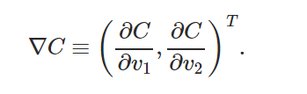
The Tangent Plane
On a single point, there is ONLY ONE plane tangent to the point. However there are INFINITE lines tangent to that point on that only plane..
The tangent line that has the maximum slope is called GRADIENT.

Slide 44
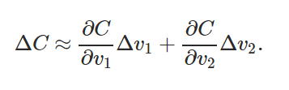
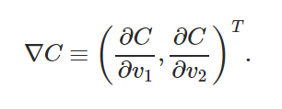



The Gradient Descent

Slide 45
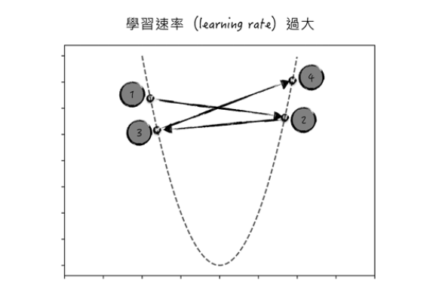
Carefully choosing

Slide 46
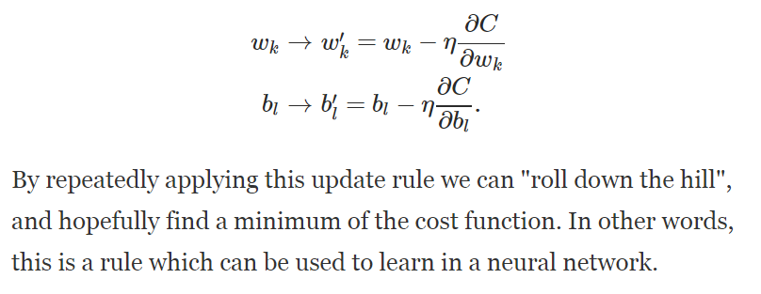
The Gradient Descent

Slide 47

The Problem of Gradient Descent
We need to compute the gradients ∇Cx separately for each training input, x, and then average them
When the number of training inputs is very large this can take a long time

Slide 48
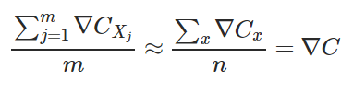
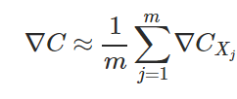
Stochastic Gradient Descent(SGD)
Choose a small m number of training inputs → MINI BATCH
Calculate the gradient of the mini batch, which equals to the real gradient of all samples.
When we have completed all the batches once, it’s called an EPOCH
After that we start a new epoch.

Slide 49
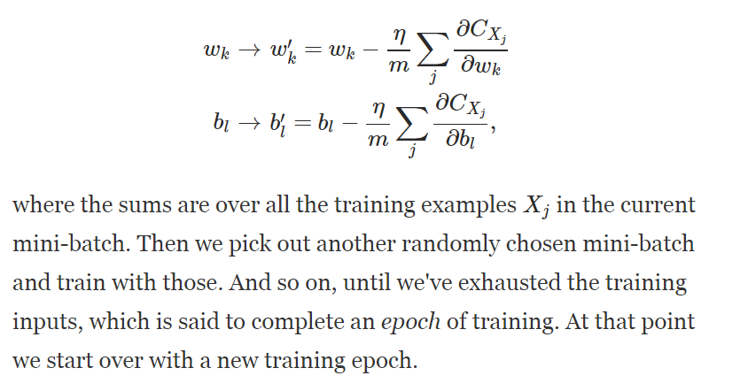
Stochastic Gradient Descent(SGD)

Slide 50

Stochastic Gradient Descent(SGD)
It is like political POLLING, easier to get small number of sample vs. all samples
For MNIST, choose a mini-batch of size 100, for 60000 samples.
The gradient of the mini batch is NOT perfect, but good enough to do SGD.
Only need 600 times to get the true gradient.

Slide 51
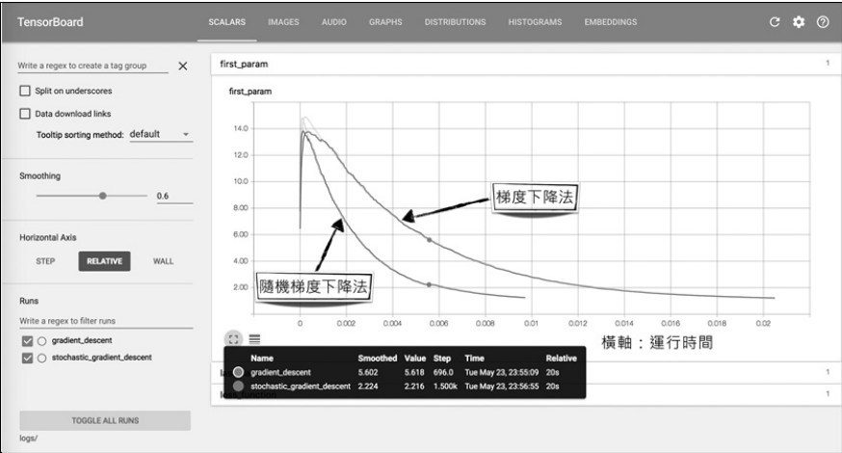
SGD: Faster Converging

Slide 52
Loss graph
Loss (w=0) | Loss (w=1) | Loss (w=2) | Loss (w=3) | Loss (w=4)
mean=56/3=18.7 | mean=14/3=4.7 | mean=0 | mean=14/3=4.7 | mean=56/3=18.7
Notes:
loss = (\hat{y}-y)^2 = (x*w-y)^2

Slide 53
Linear Regression error?

Slide 54

What is the learning: find w that minimizes the loss
Loss (w=0) | Loss (w=1) | Loss (w=2) | Loss (w=3) | Loss (w=4)
mean=56/3=18.7 | mean=14/3=4.7 | mean=0 | mean=14/3=4.7 | mean=56/3=18.7
Notes:
loss = (\hat{y}-y)^2 = (x*w-y)^2

Slide 55
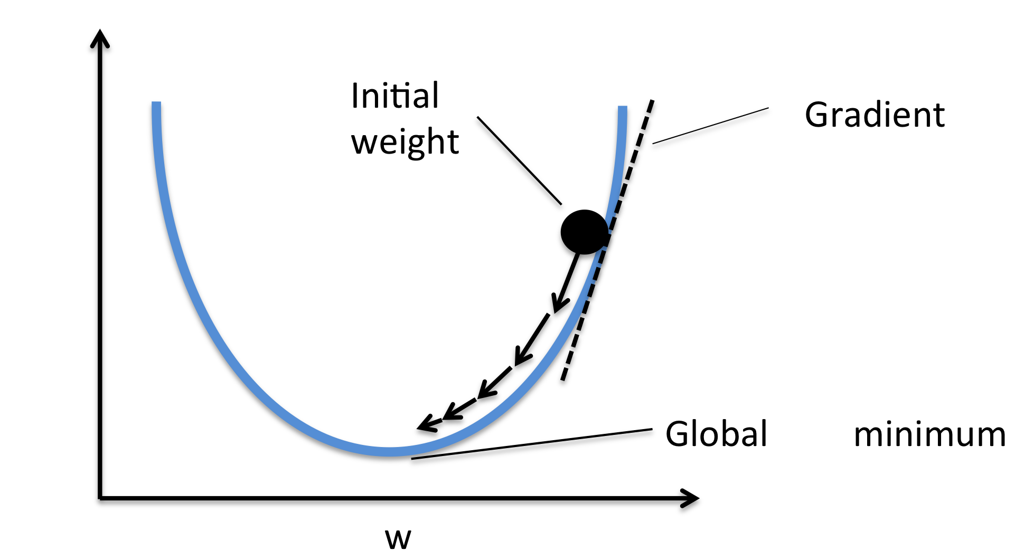

Gradient descent algorithm
loss
loss
Notes:
loss = (\hat{y}-y)^2 = (x*w-y)^2
\frac{\partial{loss}}{\partial{w}}=?

Slide 56


Gradient descent algorithm
loss
loss
Notes:
loss = (\hat{y}-y)^2 = (x*w-y)^2
\frac{\partial{loss}}{\partial{w}}=?

Slide 57
Derivative
Notes:
loss = (\hat{y}-y)^2 = (x*w-y)^2
\frac{\partial{loss}}{\partial{w}}=?

Slide 58

Derivative
Notes:
loss = (\hat{y}-y)^2 = (x*w-y)^2
\frac{\partial{loss}}{\partial{w}}=?

Slide 59
Derivative
Notes:
loss = (\hat{y}-y)^2 = (x*w-y)^2
\frac{\partial{loss}}{\partial{w}}=?

Slide 60
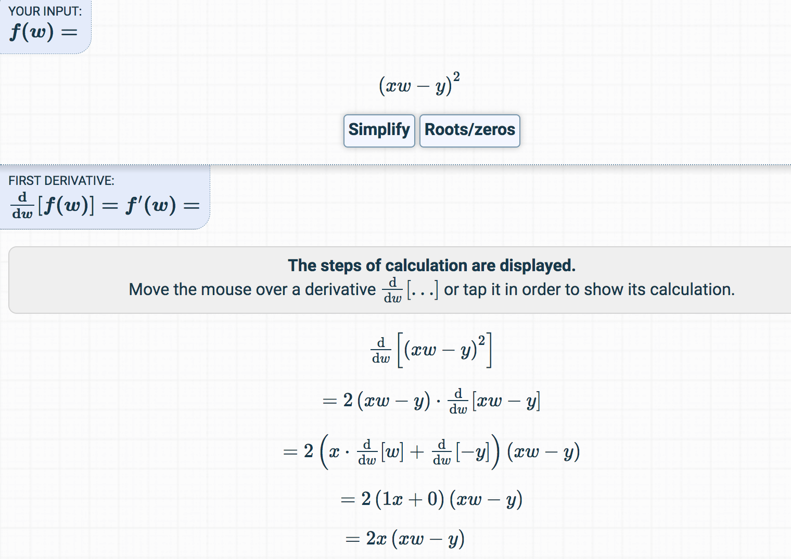
Derivative
https://www.derivative-calculator.net/
Notes:
loss = (\hat{y}-y)^2 = (x*w-y)^2
\frac{\partial{loss}}{\partial{w}}=?

Slide 61

Let’s implement!
loss
loss
Notes:
loss = (\hat{y}-y)^2 = (x*w-y)^2
\frac{\partial{loss}}{\partial{w}}=?

Slide 62
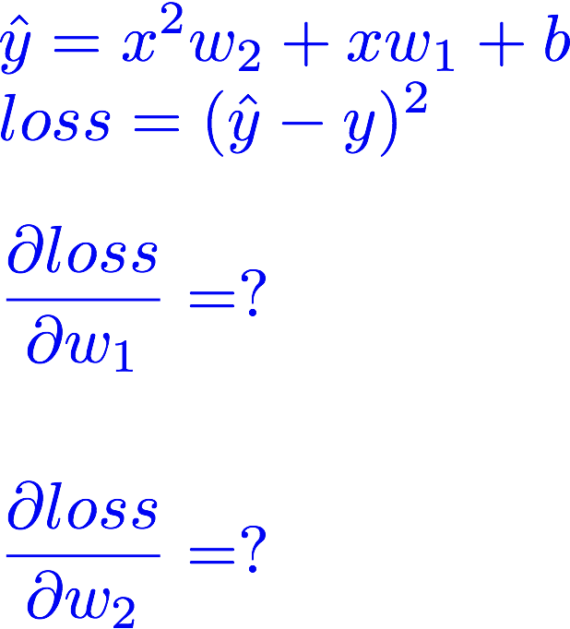
Exercise :compute gradient

Slide 63



